Slide 1
Experimental Probability Vs. Theoretical Probability

Slide 2
24
7
30
Date
Probability
EQ – What is experimental probability with replacement?

Slide 3
What do you know about probability?
Probability is a number from 0 to 1 that tells you how likely something is to happen.
Probability can have two approaches -experimental probability
-theoretical probability

Slide 4
Experimental vs.Theoretical
Experimental probability:
P(event) = number of times event occurs
total number of trials
Theoretical probability:
P(E) = number of favorable outcomes total number of possible outcomes

Slide 5
How can you tell which is experimental and which is theoretical probability?
Experimental:
You tossed a coin 10 times and recorded a head 3 times, a tail 7 times
P(head)= 3/10
P(tail) = 7/10
Theoretical:
Toss a coin and getting a head or a tail is 1/2.
P(head) = 1/2
P(tail) = 1/2

Slide 6
Experimental probability
Experimental probability is found by repeating an experiment and observing the outcomes.
P(head)= 3/10
A head shows up 3 times out of 10 trials,
P(tail) = 7/10
A tail shows up 7 times out of 10 trials

Slide 7
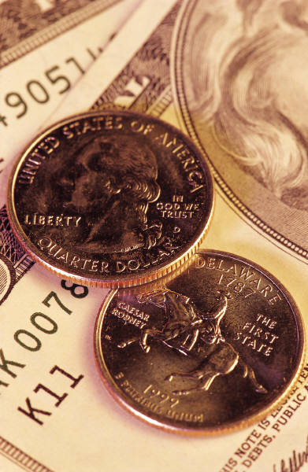
Theoretical probability
P(head) = 1/2
P(tail) = 1/2
Since there are only two outcomes, you have 50/50 chance to get a head or a tail.
HEADS
TAILS

Slide 8
Compare experimental and theoretical probability
    Both probabilities are ratios that compare the number of favorable outcomes to the total number of possible outcomes
P(head)= 3/10
P(tail) = 7/10
P(head) = 1/2
P(tail) = 1/2

Slide 9

Identifying the Type of Probability
A bag contains three red marbles and three blue marbles.
P(red) = 3/6 =1/2
Theoretical
(The result is based on the possible outcomes)

Slide 10
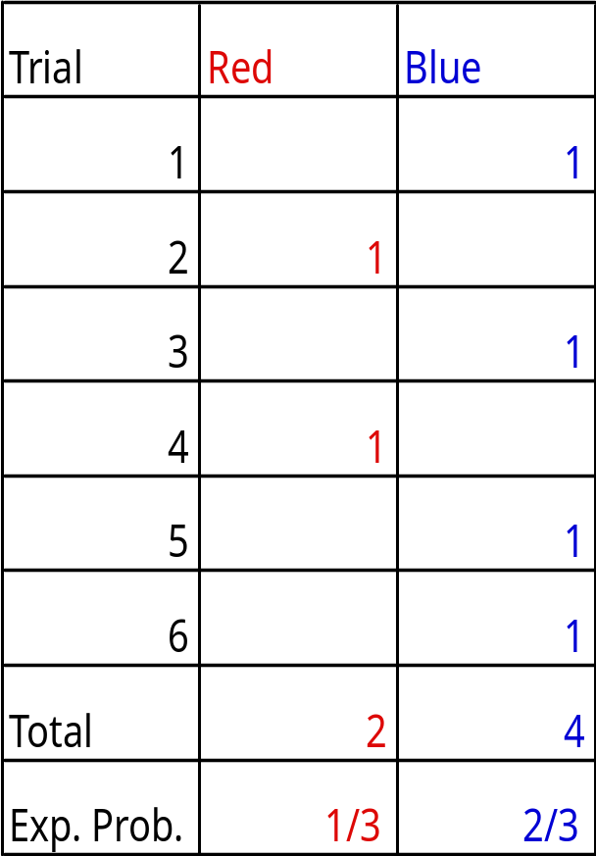
Identifying the Type of Probability
You draw a marble out of the bag, record the color, and replace the marble. After 6 draws, you record 2 red marbles
P(red)= 2/6 = 1/3
Experimental
(The result is found by repeating an experiment.)

Slide 11
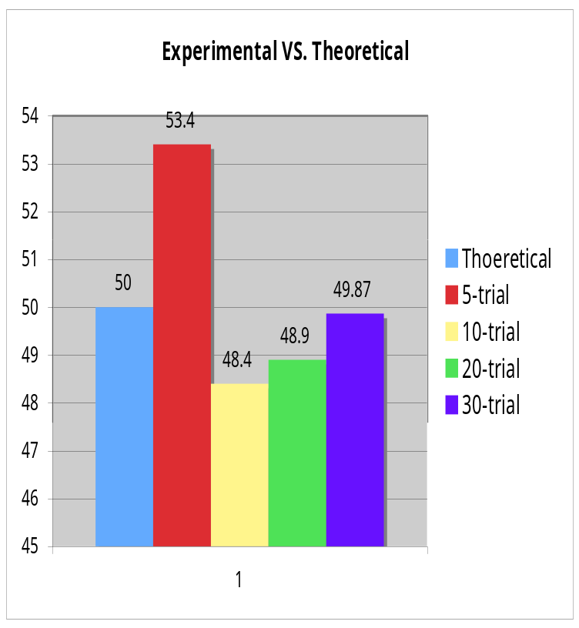
How come I never get a theoretical value in both experiments? Tom asked.
If you repeat the experiment many times, the results will getting closer to the theoretical value.
Law of the Large Numbers

Slide 12
Law of the Large Numbers 101
The Law of Large Numbers was first published in 1713 by Jocob Bernoulli.
It is a fundamental concept for probability and statistic.
This Law states that as the number of trials increase, the experimental probability will get closer and closer to the theoretical probability.
http://en.wikipedia.org/wiki/Law_of_large_numbers

Slide 13
Contrast experimental and theoretical probability
Experimental probability is the result of an experiment.
Theoretical probability is what is expected to happen.

Slide 14
Contrast Experimental and theoretical probability
Three students tossed a coin 50 times individually.
Lisa had a head 20 times. ( 20/50 = 0.4)
Tom had a head 26 times. ( 26/50 = 0.52)
Al had a head 28 times. (28/50 = 0.56)
Please compare their results with the theoretical probability.
It should be 25 heads. (25/50 = 0.5)

Slide 15
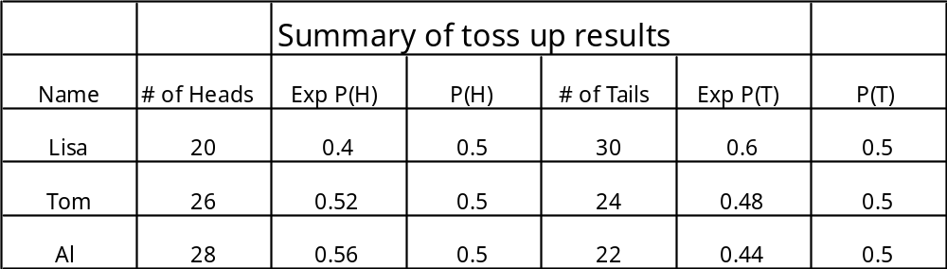
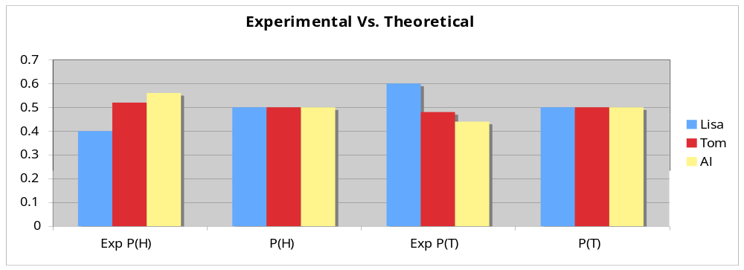
Contrast Experimental and theoretical probability

Slide 16
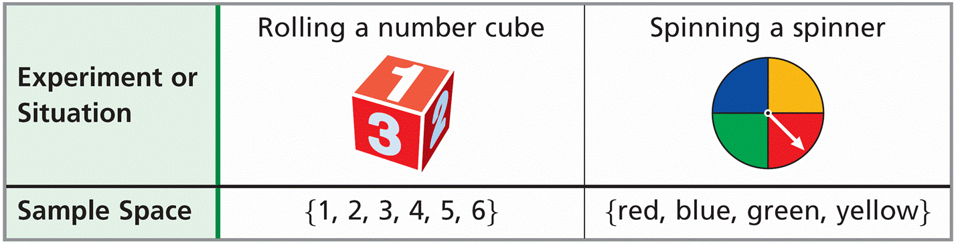
Probability is the measure of how likely an event is to occur. Each possible result of a probability experiment or situation is an outcome. The sample space is the set of all possible outcomes. An event is an outcome or set of outcomes.

Slide 17
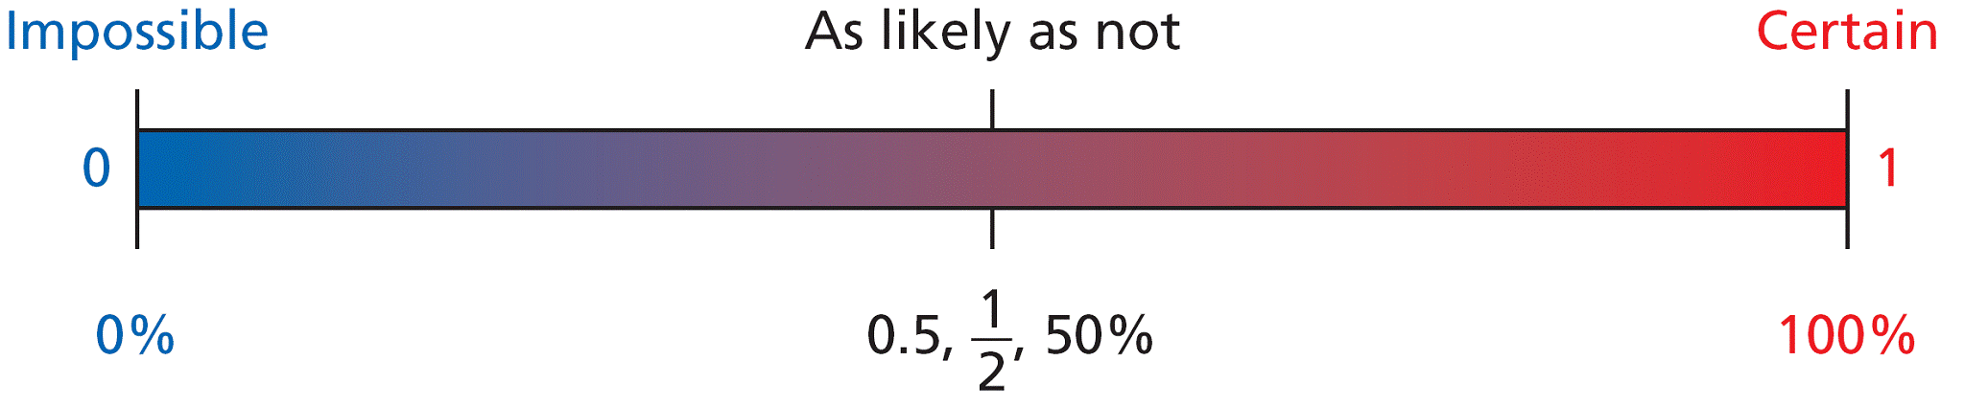
Probabilities are written as fractions or decimals from 0 to 1, or as percents from 0% to 100%.

Slide 18
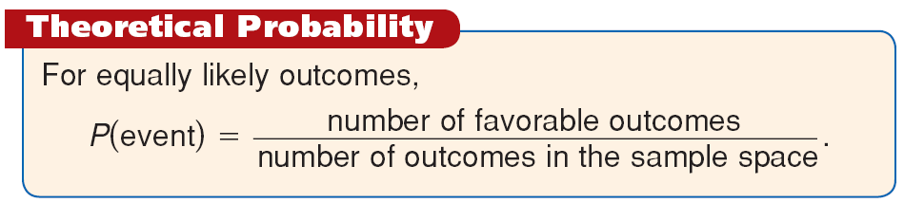
Equally likely outcomes have the same chance of occurring. When you toss a fair coin, heads and tails are equally likely outcomes. Favorable outcomes are outcomes in a specified event. For equally likely outcomes, the theoretical probability of an event is the ratio of the number of favorable outcomes to the total number of outcomes.

Slide 19

Example 1A: Finding Theoretical Probability
Each letter of the word PROBABLE is written on a separate card. The cards are placed face down and mixed up. What is the probability that a randomly selected card has a consonant?
There are 8 possible outcomes and 5 favorable outcomes.

Slide 20
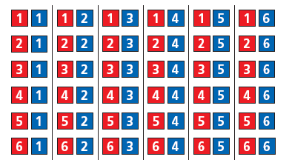

Example 1B: Finding Theoretical Probability
Two number cubes are rolled. What is the probability that the difference between the two numbers is 4?
There are 36 possible outcomes.
4 outcomes with a difference of 4: (1, 5), (2, 6), (5, 1), and (6, 2)

Slide 21
Check It Out! Example 1a
A red number cube and a blue number cube are rolled. If all numbers are equally likely, what is the probability of the event?
The sum is 6.

Slide 22
Check It Out! Example 1b
A red number cube and a blue number cube are rolled. If all numbers are equally likely, what is the probability of the event?
The difference is 6.

Slide 23
Check It Out! Example 1c
A red number cube and a blue number cube are rolled. If all numbers are equally likely, what is the probability of the event?
The red cube is greater.

Slide 24
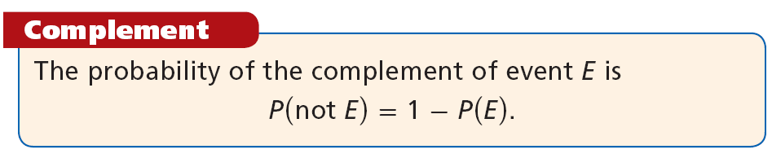
The sum of all probabilities in the sample space is 1. The complement of an event E is the set of all outcomes in the sample space that are not in E.

Slide 25
Example 2: Application
There are 25 students in study hall. The table shows the number of students who are studying a foreign language. What is the probability that a randomly selected student is not studying a foreign language?
Language | Number
French | 6
Spanish | 12
Japanese | 3

Slide 26


Example 2 Continued
P(not foreign) = 1 – P(foreign)
Use the complement.
There are 21 students studying a foreign language.
, or 16%
There is a 16% chance that the selected student is not studying a foreign language.

Slide 27
Check It Out! Example 2
Two integers from 1 to 10 are randomly selected. The same number may be chosen twice. What is the probability that both numbers are less than 9?

Slide 28
Example 3: Finding Probability with Permutations or Combinations
Each student receives a 5-digit locker combination. What is the probability of receiving a combination with all odd digits?
Step 1 Determine whether the code is a permutation or a combination.
Order is important, so it is a permutation.

Slide 29
Example 3 Continued
Step 2 Find the number of outcomes in the sample space.
number number number number number
10 × 10 × 10 × 10 × 10 = 100,000
There are 100,000 outcomes.

Slide 30
Example 3 Continued
Step 3 Find the number of favorable outcomes.
odd odd odd odd odd
5 × 5 × 5 × 5 × 5 = 3125
There are 3125 favorable outcomes.

Slide 31


Example 3 Continued
Step 4 Find the probability.
The probability that a combination would have only odd digits is

Slide 32
Check It Out! Example 3
A DJ randomly selects 2 of 8 ads to play before her show. Two of the ads are by a local retailer. What is the probability that she will play both of the retailer’s ads before her show?

Slide 33
Geometric probability is a form of theoretical probability determined by a ratio of lengths, areas, or volumes.

Slide 34
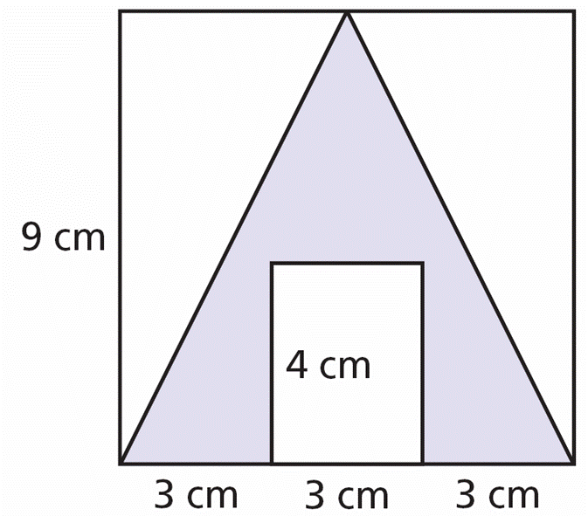
Example 4: Finding Geometric Probability
A figure is created placing a rectangle inside a triangle inside a square as shown. If a point inside the figure is chosen at random, what is the probability that the point is inside the shaded region?

Slide 35

Example 4 Continued
Find the ratio of the area of the shaded region to the area of the entire square. The area of a square is s², the area of a triangle is , and the area of a rectangle is lw.
First, find the area of the entire square.
A_{t} = (9)² = 81
Total area of the square.

Slide 36


Example 4 Continued
Next, find the area of the triangle.
Area of the triangle.
Next, find the area of the rectangle.
A_{rectangle} = (3)(4) = 12
Area of the rectangle.
Subtract to find the shaded area.
A_{s} = 40.5 – 12 = 28.5
Area of the shaded region.
Ratio of the shaded region to total area.

Slide 37
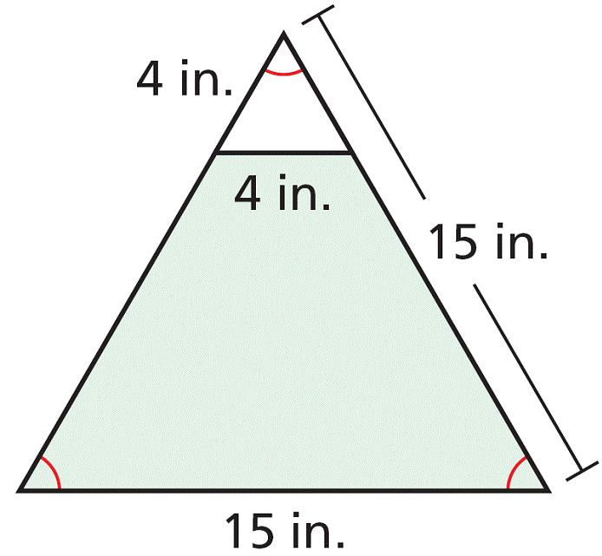
Check It Out! Example 4
Find the probability that a point chosen at random inside the large triangle is in the small triangle.

Slide 38
You can estimate the probability of an event by using data, or by experiment. For example, if a doctor states that an operation “has an 80% probability of success,” 80% is an estimate of probability based on similar case histories.
Each repetition of an experiment is a trial. The sample space of an experiment is the set of all possible outcomes. The experimental probability of an event is the ratio of the number of times that the event occurs, the frequency, to the number of trials.

Slide 39
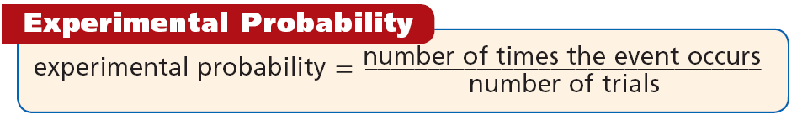
Experimental probability is often used to estimate
theoretical probability and to make predictions.

Slide 40

Example 5A: Finding Experimental Probability
The table shows the results of a spinner experiment. Find the experimental probability.
Number | Occurrences
1 | 6
2 | 11
3 | 19
4 | 14
spinning a 4
The outcome of 4 occurred 14 times out of 50 trials.

Slide 41

Example 5B: Finding Experimental Probability
The table shows the results of a spinner experiment. Find the experimental probability.
Number | Occurrences
1 | 6
2 | 11
3 | 19
4 | 14
spinning a number greater than 2
The numbers 3 and 4 are greater than 2.
3 occurred 19 times and 4 occurred 14 times.

Slide 42
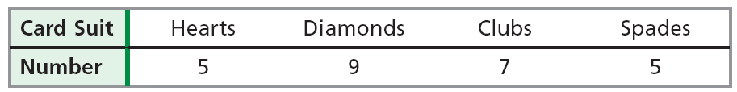
Check It Out! Example 5a
The table shows the results of choosing one card from a deck of cards, recording the suit, and then replacing the card.
Find the experimental probability of choosing a diamond.

Slide 43
Check It Out! Example 5b
The table shows the results of choosing one card from a deck of cards, recording the suit, and then replacing the card.
Find the experimental probability of choosing a card that is not a club.

Slide 44
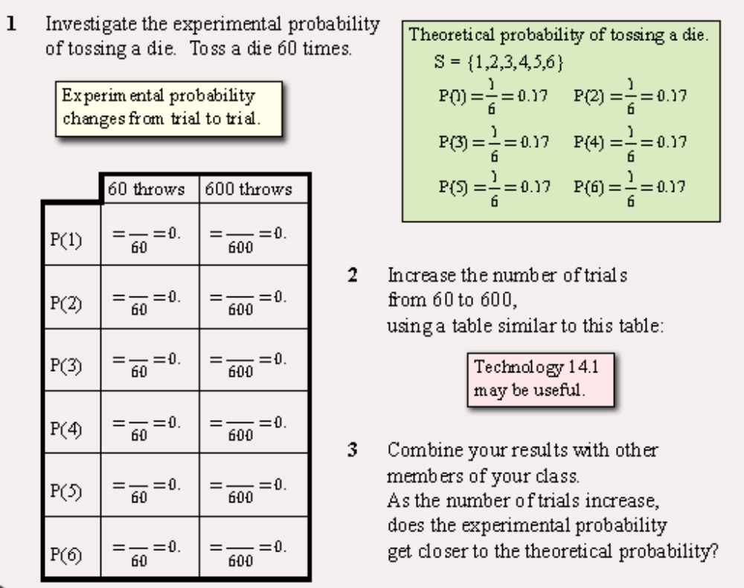

Slide 45
